Slide 1


Evaluating Cumulative Spectral Gradient as a Complexity Measure
Haji Gul (23h1710@ubd.edu.bn), Abdul Ghani Naim, Ajaz Ahmad Bhat (ajaz.bhat@ubd.edu.bn)
School of Digital Science, Universiti Brunei Darussalam, Brunei Darussalam
This work has been accepted to the 4th Muslims in ML Workshop Co-located with ICML 2025.

Slide 2
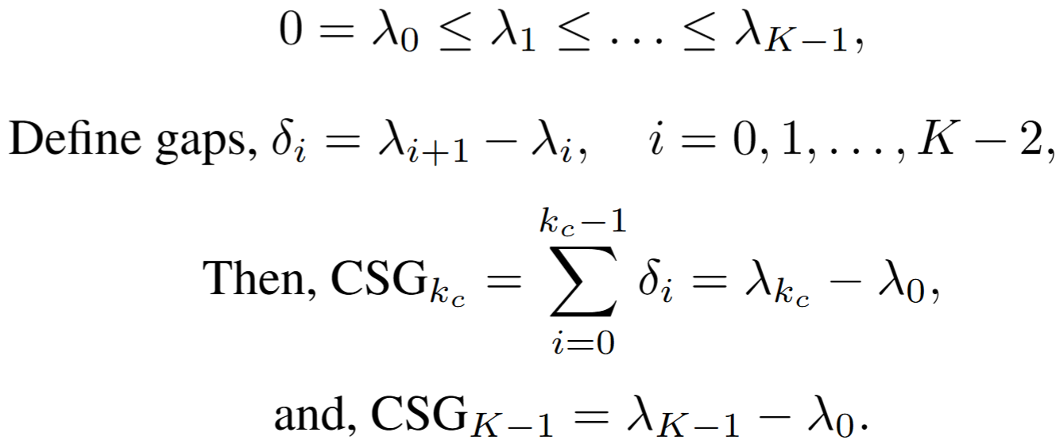
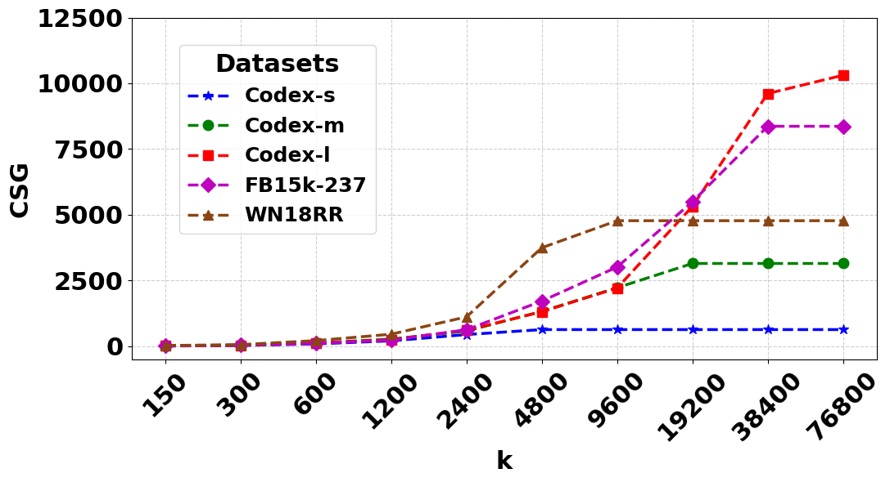
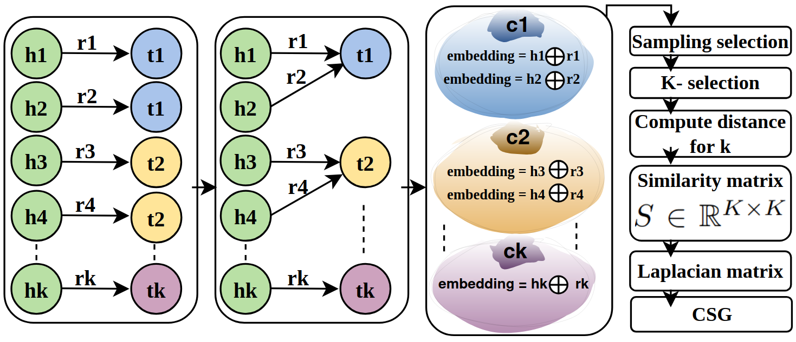
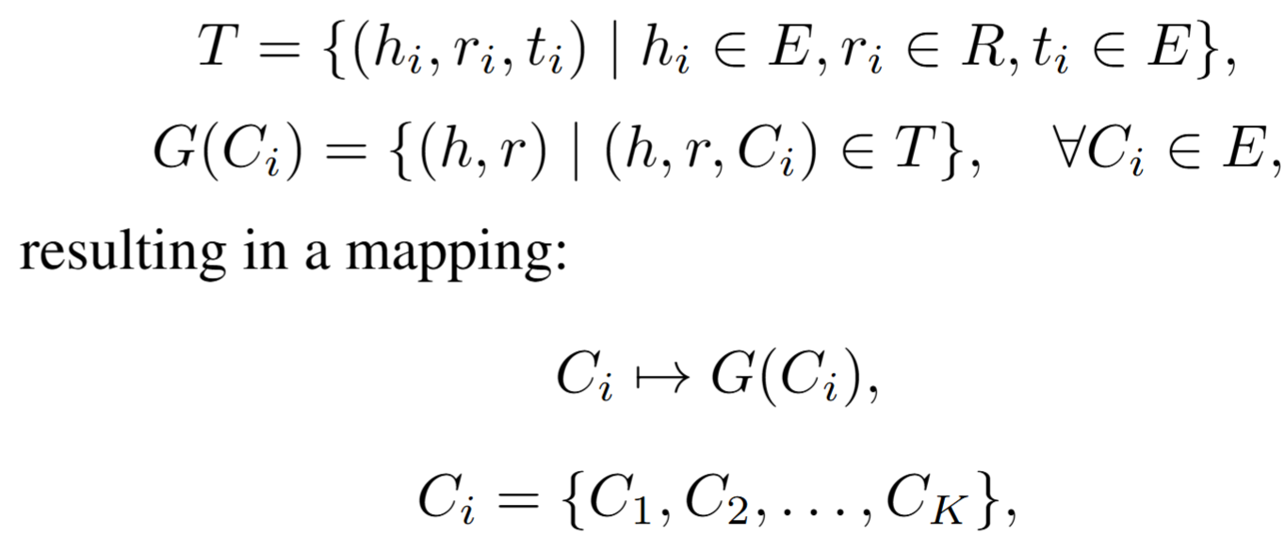
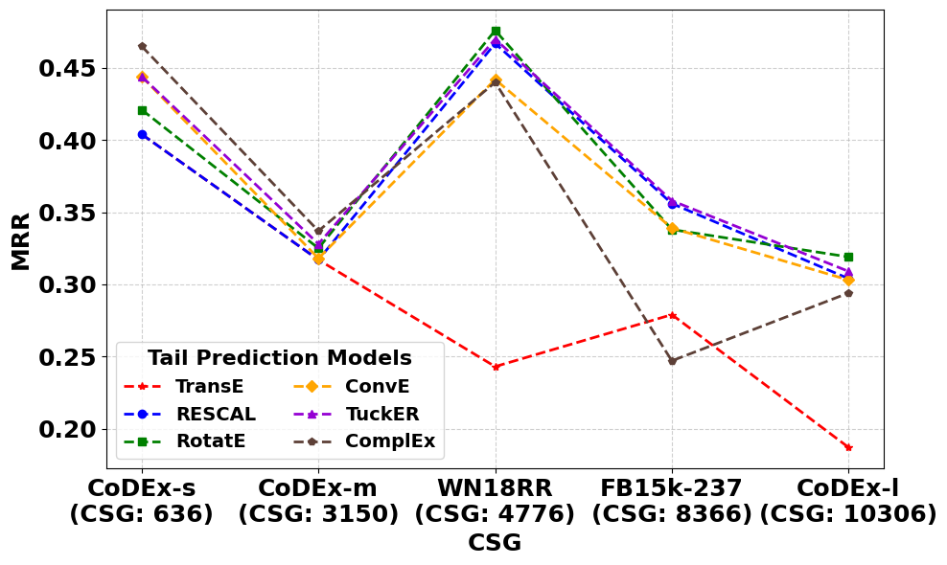
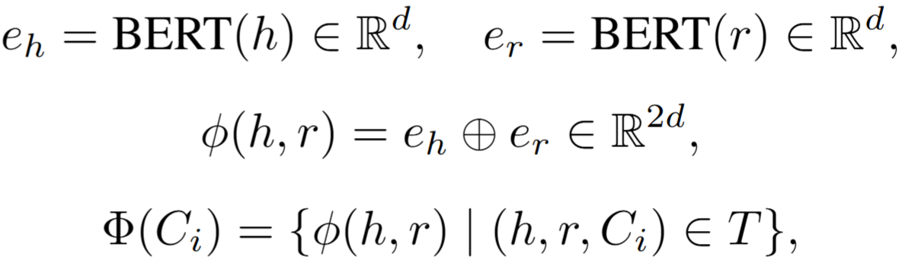
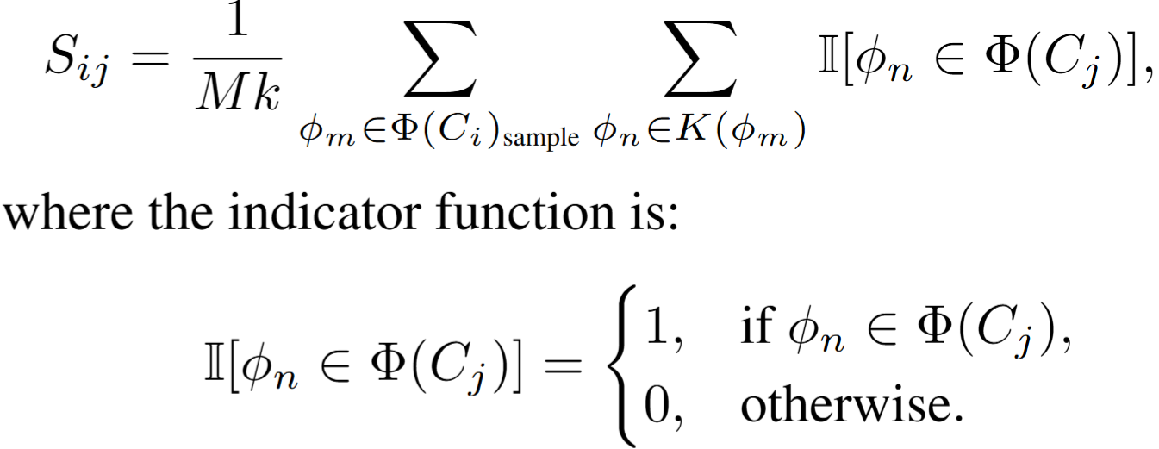
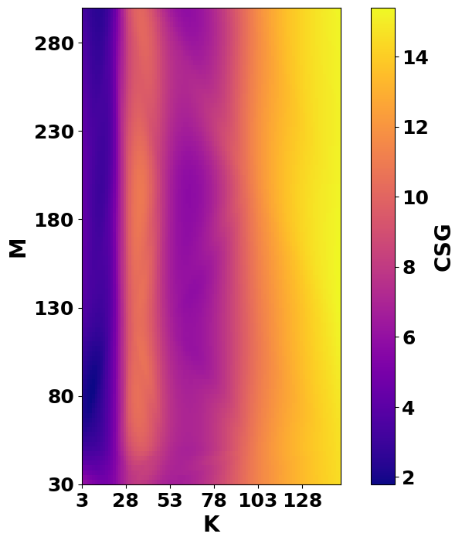
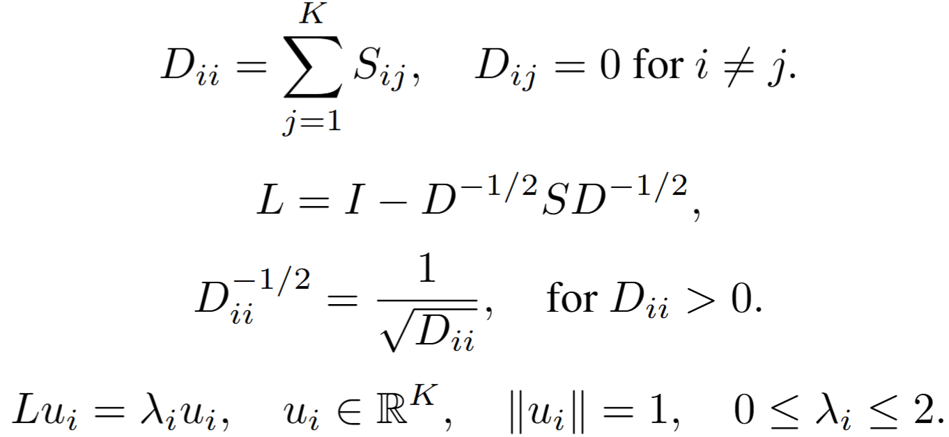
Introduction
Step 5) Cumulative Spectral Gradient :
Methodology Graphical View:
Role of K: CSG is deeply sensitive to K.
Weak MRR Correlation: CSG does not show much strong correlation with MRR (R = −0.64).
This study evaluates the complexity of the tail prediction task in knowledge graphs.
Challenge: Metrics like MRR measure performance but not dataset complexity.
Research Questions:
Is CSG sensitive to parameters K (neighbors) and M (samples)?
Does CSG correlate with MRR in KGs?
How do K and M (sample size) influence CSGs’ complexity estimation?
Methodology
Step 1) Grouping by Tail Entities:
Step 2) Generate embeddings:
Step 3) Build a similarity matrix:
Step 4) Graph Laplacian and Spectral Analysis:
Figure 3: CSG as a function of K values at M = 100
Figure 1: Proposed KG-CSG Methodology
Results
Datasets: FB15k-237, WN18RR, CoDEx-S, CoDEx-M, CoDEx-L
Sensitivity to M: For small K, M become stable CSG, but its impact is less pronounced than K’s.
Figure 4: Relation between CSG and MRR.
Conclusion
CSG is significantly influenced by the K and M, challenging previous assumptions that K and M had minimal impact
Parameters K and M deeply influence results.
Poor relation between CSG and performance (MRR).
Future work focus on developing complexity measures tailored to the characteristics of knowledge graphs.
Figure 2: CSG as a function of M and K values

